Slide 1
Azure IoT End-to-End
Martin Abbott
@martinabbott

Slide 2
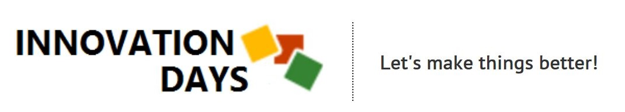
Use the twitter handles:
#innovationdays @_innovationdays
Top twitter of the day will win a gift

Slide 3
The IoT challenge
Devices are often embedded systems, fully automated
Devices can be in remote or inhospitable locations, where physical access is dangerous
Once deployed, devices may only be reachable through a backend system
Devices may have limited power and processing resources requiring wake ups and occasionally on scenarios
Connectivity may be intermittent, slow, or expensive
Connectivity may need proprietary, custom, or industry-specific application protocols

Slide 4
Communication in the IoT
Telemetry
Query
Notification
Command

Slide 5
Event Hub vs IoT Hub
Feature | Event Hub | IoT Hub
Communication patterns | Telemetry | Telemetry, Query, Notification, Command
Protocol Support | AMQP, AMQP over WebSockets, HTTP | As Event Hub but also MQTT and custom protocols through IoT Protocol Gateway
Security | Shared Access Policies | Per device security, SAS, revocation
Scale | Huge scale | Huge scale
SDKs | Many languages supported plus direct AMQP and HTTP interfaces | Many languages supported plus direct AMQP, HTTP and MQTT interfaces
Monitoring | Aggregated metrics | Extensive list of diagnostic and operational metrics including security and connectivity

Slide 6
IoT Hub walkthrough
It’s about security
  Service Assisted Communication *
  Security is paramount (cf. SCADA)
  Devices registry, peer-to-peer
  Per device authentication with SAS token (from device id and device key)
  Secured via an encrypted channel at the application protocol level (SSL/TLS)
It’s about both directions
  Devices need to send and receive information
  IoT Hub maintains device specific queues (inbox / outbox) to store and forward
  Devices only send and receive to channels they trust and are peered with
* “Service Assisted Communication” for Connected Devices by Clemens Vasters (@clemensv)

Slide 7
IoT Hub walkthrough
It’s about operations
  Device identity operations
  Device telemetry
  Cloud-to-device commands
  Connections
It’s about huge scale
  Pay for what you need (message metering at 4KB, D2C max size 256KB, C2D max size 64KB)
    S1 with 200 units allows ~1K messages/sec
    S2 with 200 units allows ~14K messages/sec
  Provisioning APIs provide automation
  Think mine sites, smart meters, connected cars and connected cows

Slide 8
Anatomy of IoT Hub

Slide 9
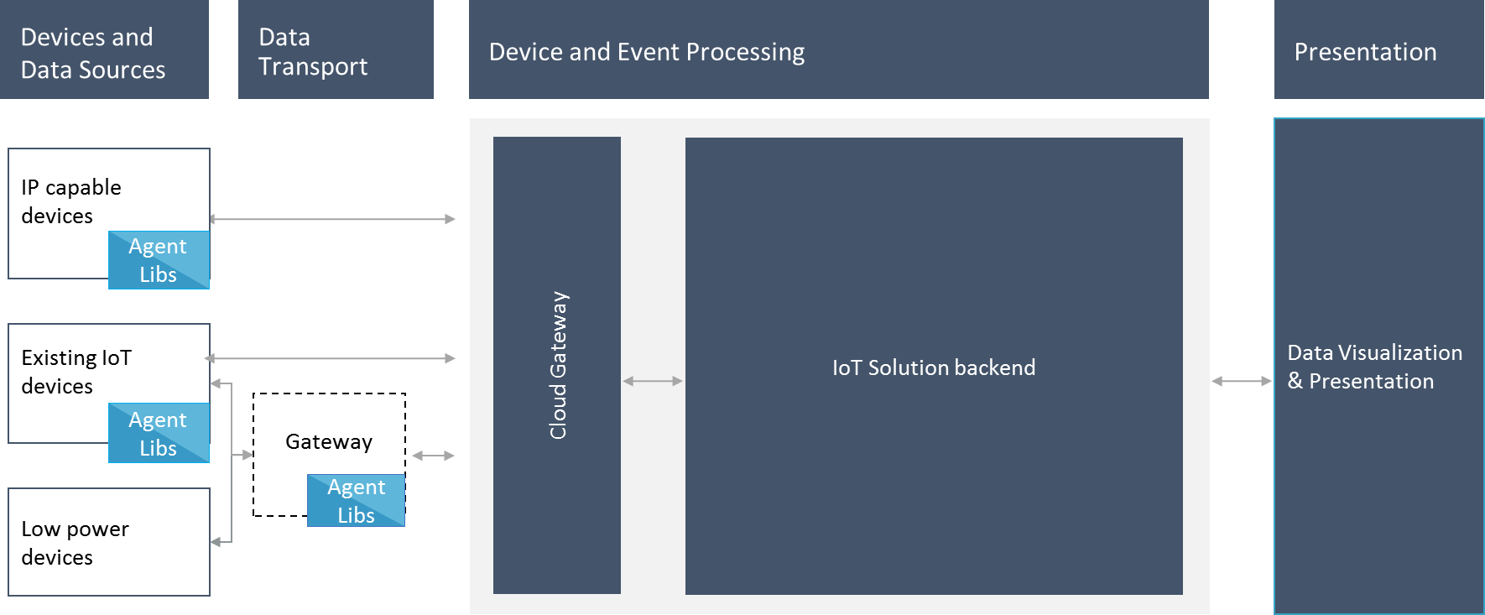
IoT Hub Reference Architecture

Slide 10
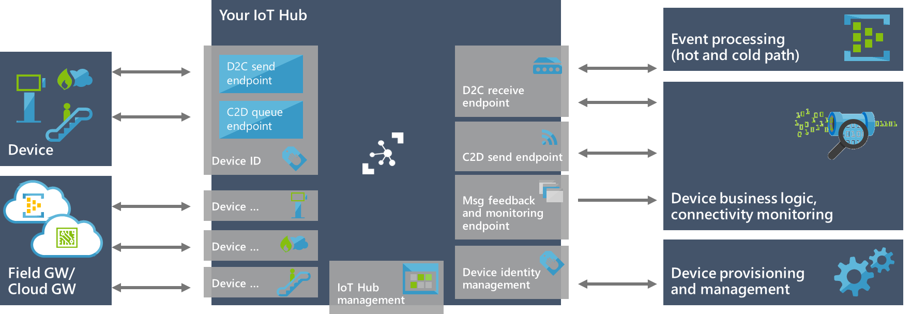
IoT and big data
Gather it
  Devices & Field Gateways
Receive it
  IoT Hub
Analyse it
  Azure Stream Analytics
  Machine Learning
React to it
  Functions
  Logic Apps
  Line of Business apps
Store it
  SQL Database
  DocumentDB
Visualise it
  Web
  PowerBI
Send it
  IoT Hub

Slide 11
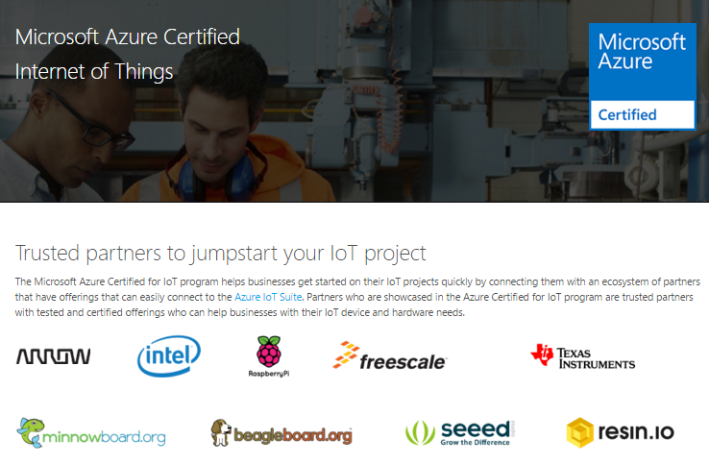
Device, device, device
Example systems
  Windows 10 IoT Core, .NET, Node.js, Python
  Linux, Python, Qpid, HTTP
  RTOS, C, MQTT
Prototyping platforms
  Raspberry Pi 2 / 3
  Grove Pi
  Arduino and shields
  Minnowboard Max
  etc.
Sensors for everything

Slide 12
Device registration and management
Device registration using RegistryManager class
Bulk import or export the registry to synchronise from or to blob storage
Device twin, additional metadata
RESTful HTTP API for device registration
C++ libraries for management and distribution of firmware
Uses CoAP not MQTT
Updates to device configuration can be performed through command and control

Slide 13
Device Management
C++ libraries for distribution of firmware
Uses CoAP not MQTT
Currently difficult to use
Updates to device configuration can be performed through command and control

Slide 14
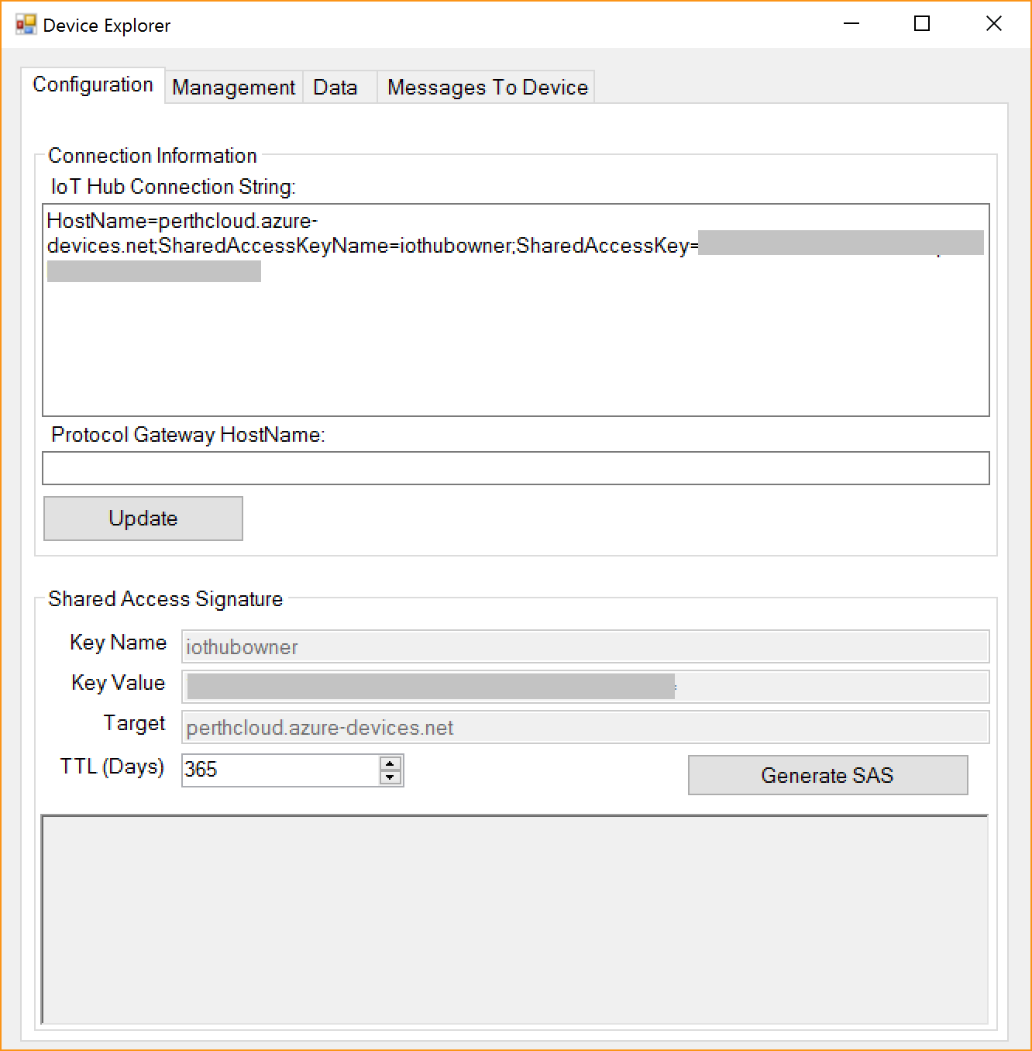
Device Explorer
Great tool for starting with IoT Hub
Create and manage devices easily
Receive data from devices
Send messages to devices
Generate SAS keys with a given expiry

Slide 15
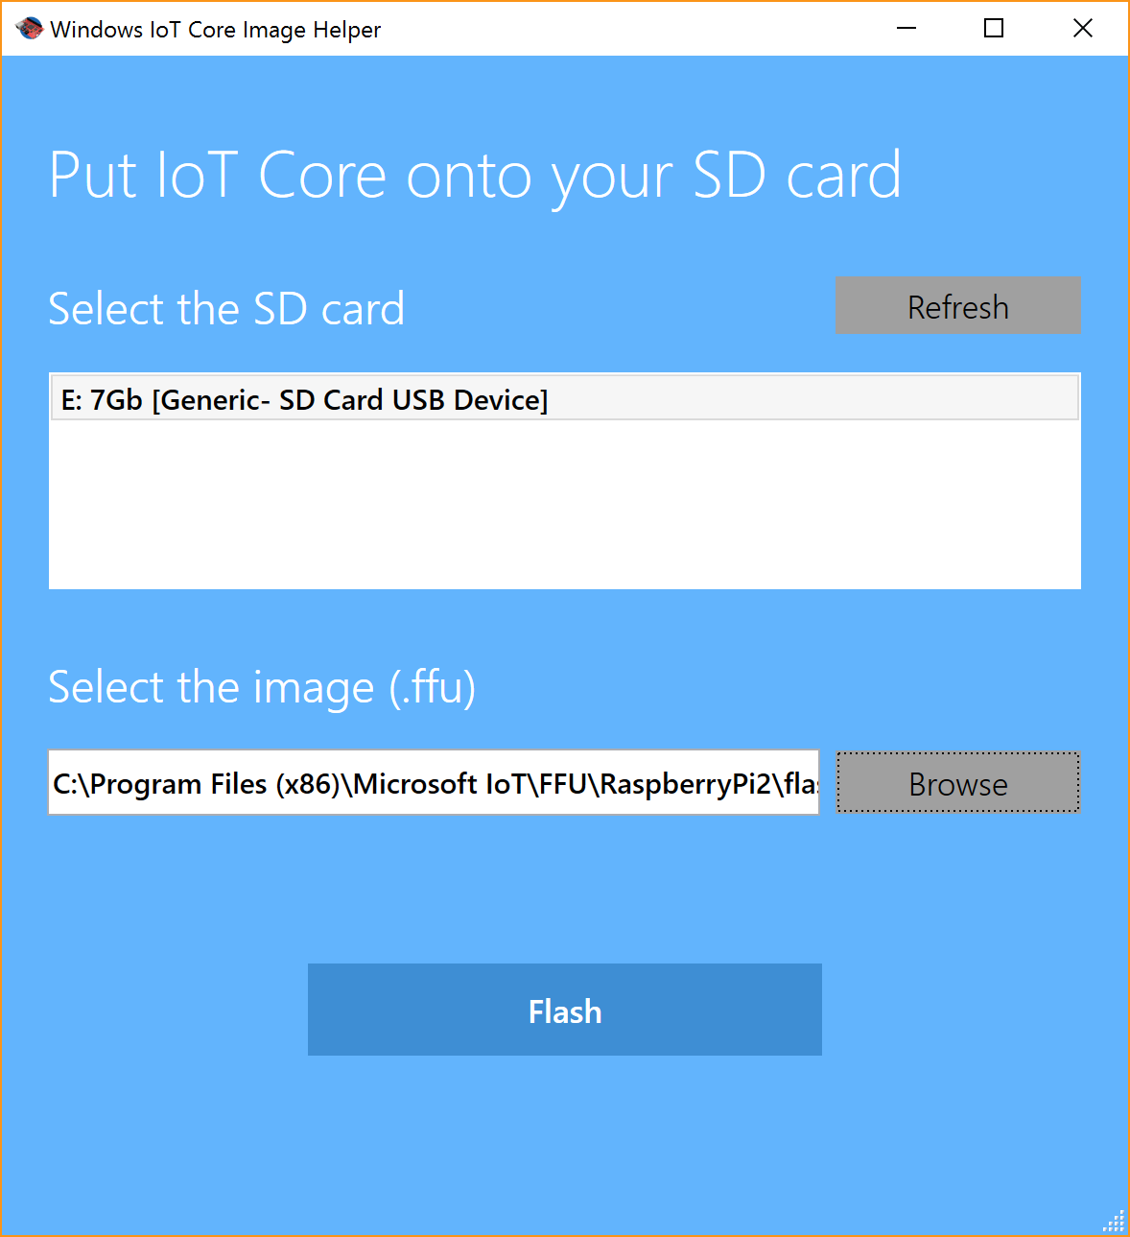
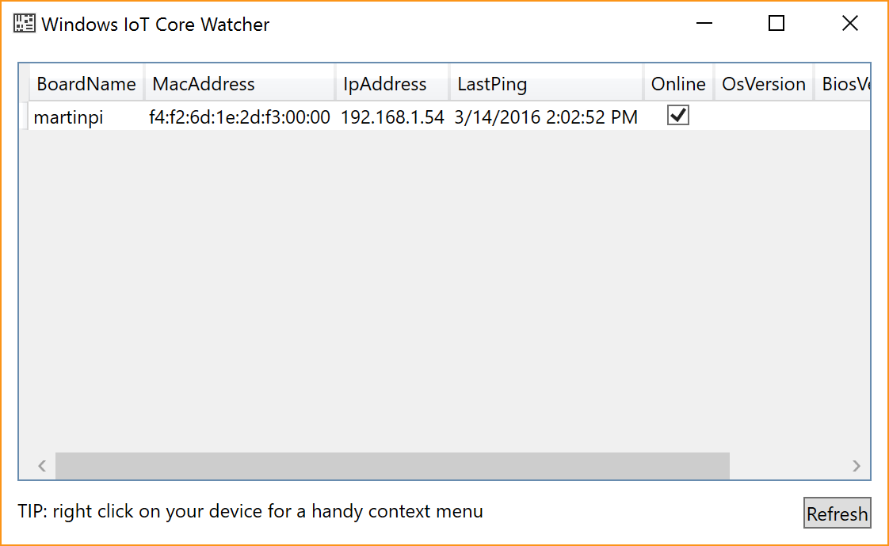
Other useful tools
For devices
  Windows 10 IoT Core Dashboard
  Windows 10 IoT Core Image Helper
  Windows 10 IoT Core Watcher
  Web-based access to Windows 10 IoT Core device
For Visual Studio
  Connected Service for IoT Hub
    For device and service templates

Slide 16






Demo architecture
Building management solution
IoT Hub
Stream Analytics allmessages
Table allmessages
Room Console App
Service Bus Queue maxtemp
Stream Analytics maxtemp
Raspberry Pi 2 Sprinker System
WebJob Process Queue

Slide 17
IoT Hub End-to-End

Slide 18
Azure IoT Suite
Can be hard to know where to start; enter IoT Suite, fully pre-configured solutions
Remote Monitoring
  Connect and monitor your devices to analyze untapped data and improve business outcomes by automating processes
Predictive Maintenance
  Anticipate maintenance needs and avoid unscheduled downtime by connecting and monitoring your devices
Full code available on Github

Slide 19
IoT Suite

Slide 20
Some scenarios
Smart cities, smart lighting, smart traffic management, smart energy management
Healthcare, fall detection, active management of the elderly
Agriculture, smart irrigation, vertical farming, automated farming
Engineering, aircraft engines, automotive
Food production, connected cows
Health and safety, duty of care
You can do anything with data

Slide 21
Summary
IoT is at the top of the hype cycle but it’s about more than your fridge
  Billions of devices predicted in the next 10 years
  Trillions of dollars predicted in the next 10 years
IoT Hub is Microsoft’s answer to large scale ingress and egress of device data
  Security is paramount
  Multi-protocol support and direct access via AMQP, HTTP, MQTT
  Managed SDKs for many languages
  Platform service, building blocks
Devices are the unit of IoT, many kits exist so get making!

Slide 22
More information
Azure IoT Hub : https://azure.microsoft.com/en-us/services/iot-hub/
Azure IoT Suite : http://www.azureiotsuite.com
Azure IoT Dev center : http://www.azure.com/iotdev
Azure IoT SDKs : https://github.com/Azure/azure-iot-sdks
Azure Certified IoT : https://azure.microsoft.com/en-us/marketplace/certified-iot-program/
Let’s connect : https://azure.microsoft.com/en-us/develop/iot/get-started/
IoT Protocol Gateway : https://github.com/Azure/azure-iot-protocol-gateway

Slide 23
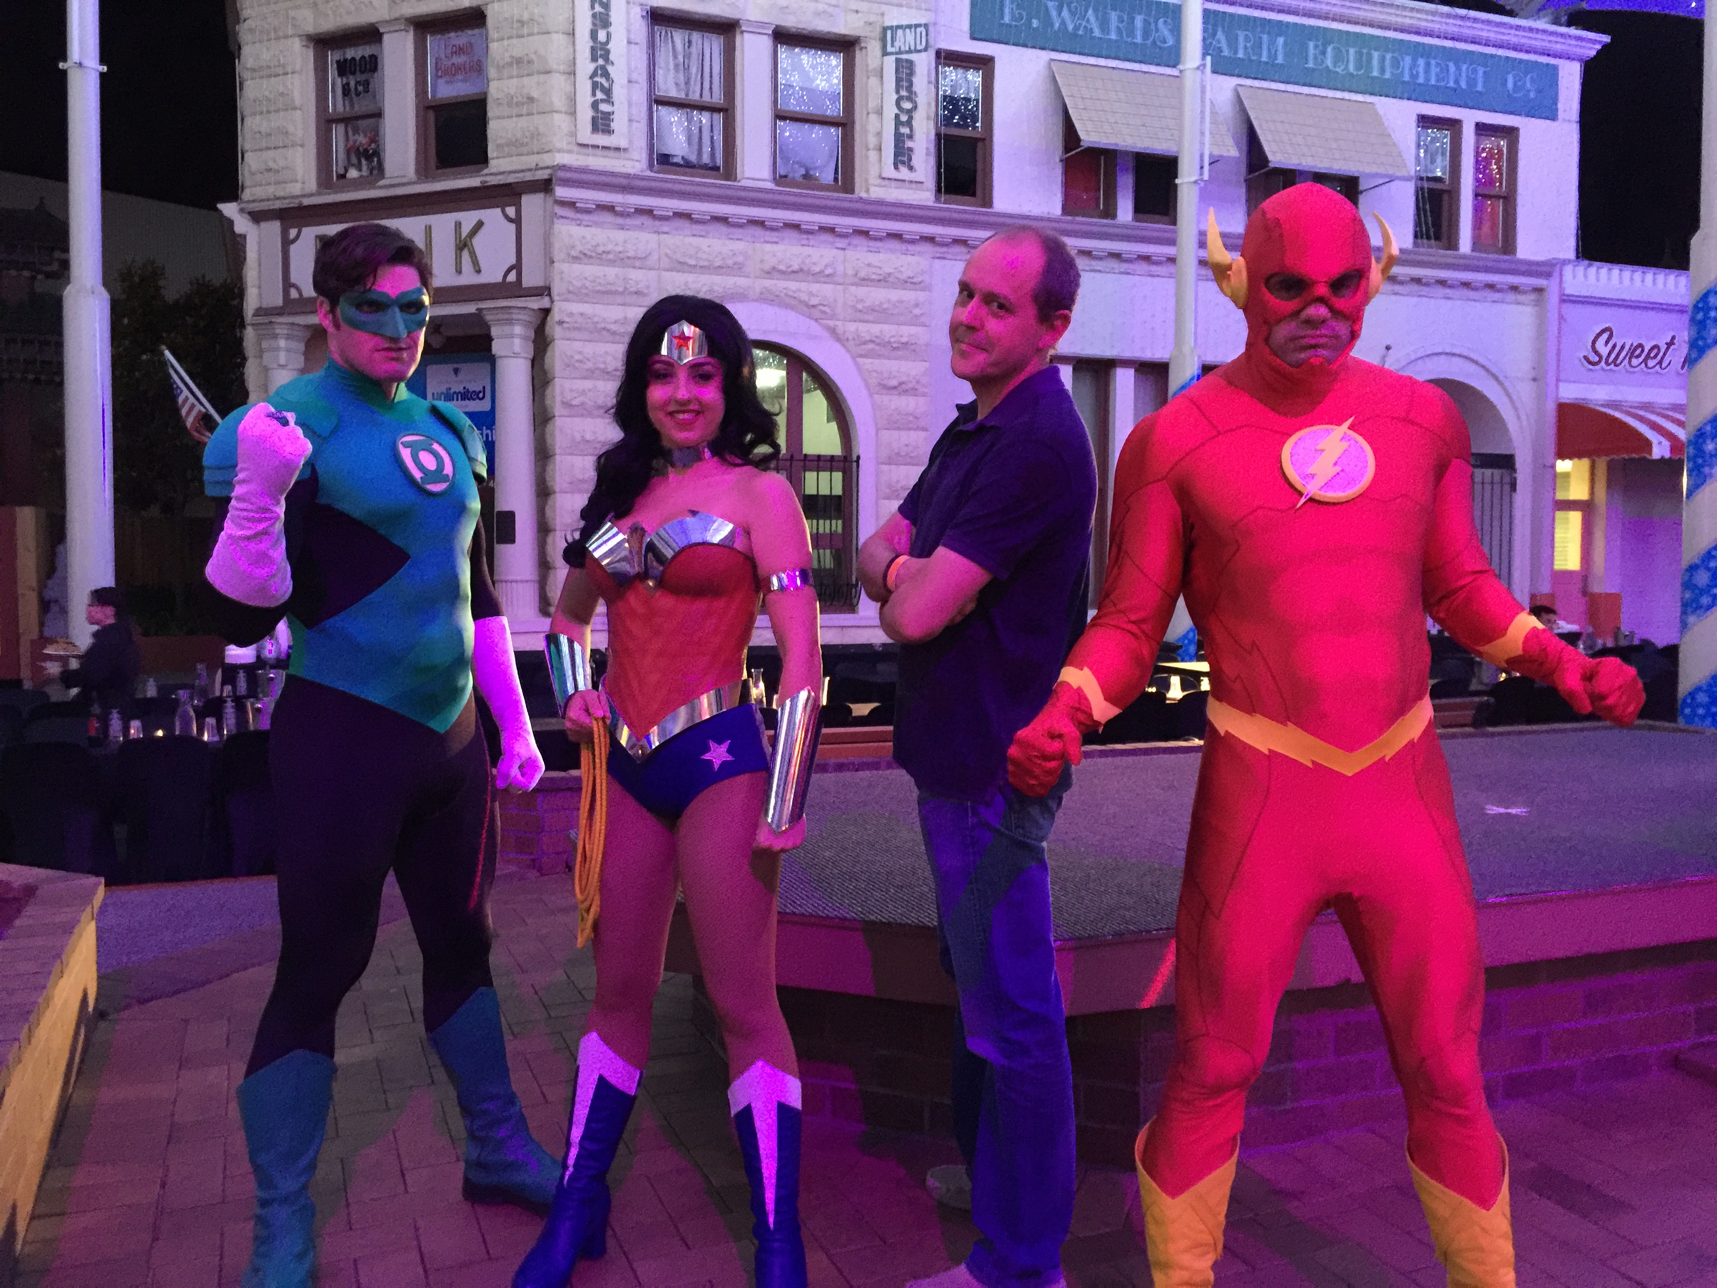
Thank you!

